Slide 1

Health and Hacking
Presented By Aashish karki, Prerana Pandit, Raznesh Prajapati, Sanjeeb Lama

Slide 2
Mental Health
Our emotional, psychological and social well-being.
It affects how we think, feel and act.

Slide 3
Problem Definition
One person dies every 40 seconds from suicide – WHO
Second leading cause of death among young people 15-29 in 2016
One in 10 young people experience a period of major depression
Close to 800,000 people die due to suicide
Source : World Health Organization

Slide 4
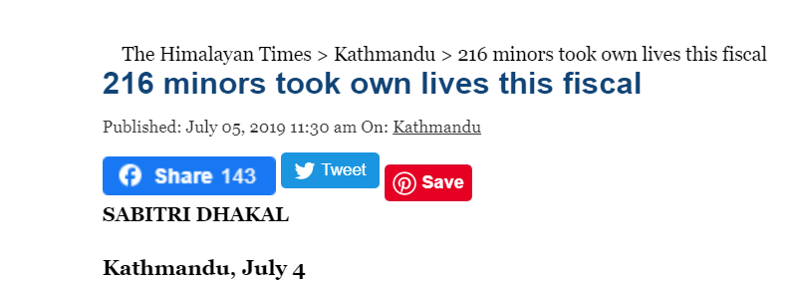
In Nepal
Suicide rate is high among the people aged between 15 and 45 years

Slide 5
Suicide rates which were only recorded
4,680
8000
2014-2015
2016-2017
2018-2019
2015-2016
2017-2018
3,974
5,124
7,144
Source : The Himalayan Times - May 2, 2019

Slide 6

We Cannot ELIMINATE

Slide 7
But we can PREVENT

Slide 8

ChangeMaker

Slide 9
ChangeMaker
Web Application
Raise awareness about Mental health problem
Provides knowledge and resources

Slide 10
ChangeMaker Features:

Slide 11

Podcast
A digital audio file
made available on the Internet
for downloading to a computer or mobile device.

Slide 12
1. Podcast
Invite professionals from different industries
To share information about current market
their struggles, mindset and journey

Slide 13

BuzzSprout
Provides Free and Cost efficient hosting plan
Provides customize Wave Podcast Player

Slide 14
2. Open Quotes
Short message
Everyone read and send message

Slide 15
Security Purpose
Two layers:
Detect and Delete
Admin || Censor Board

Slide 16
Goals || Challenges
Rural areas
Less privileged → people
Content (Experiment) →Sensitive
Requires Combined Efforts

Slide 17
Revenue Model

Slide 18

1. Advertisement
Related post

Slide 19

2. Youtube

Slide 20
3. Donation

Slide 21

Video Demo || Prototype

